Slide 1
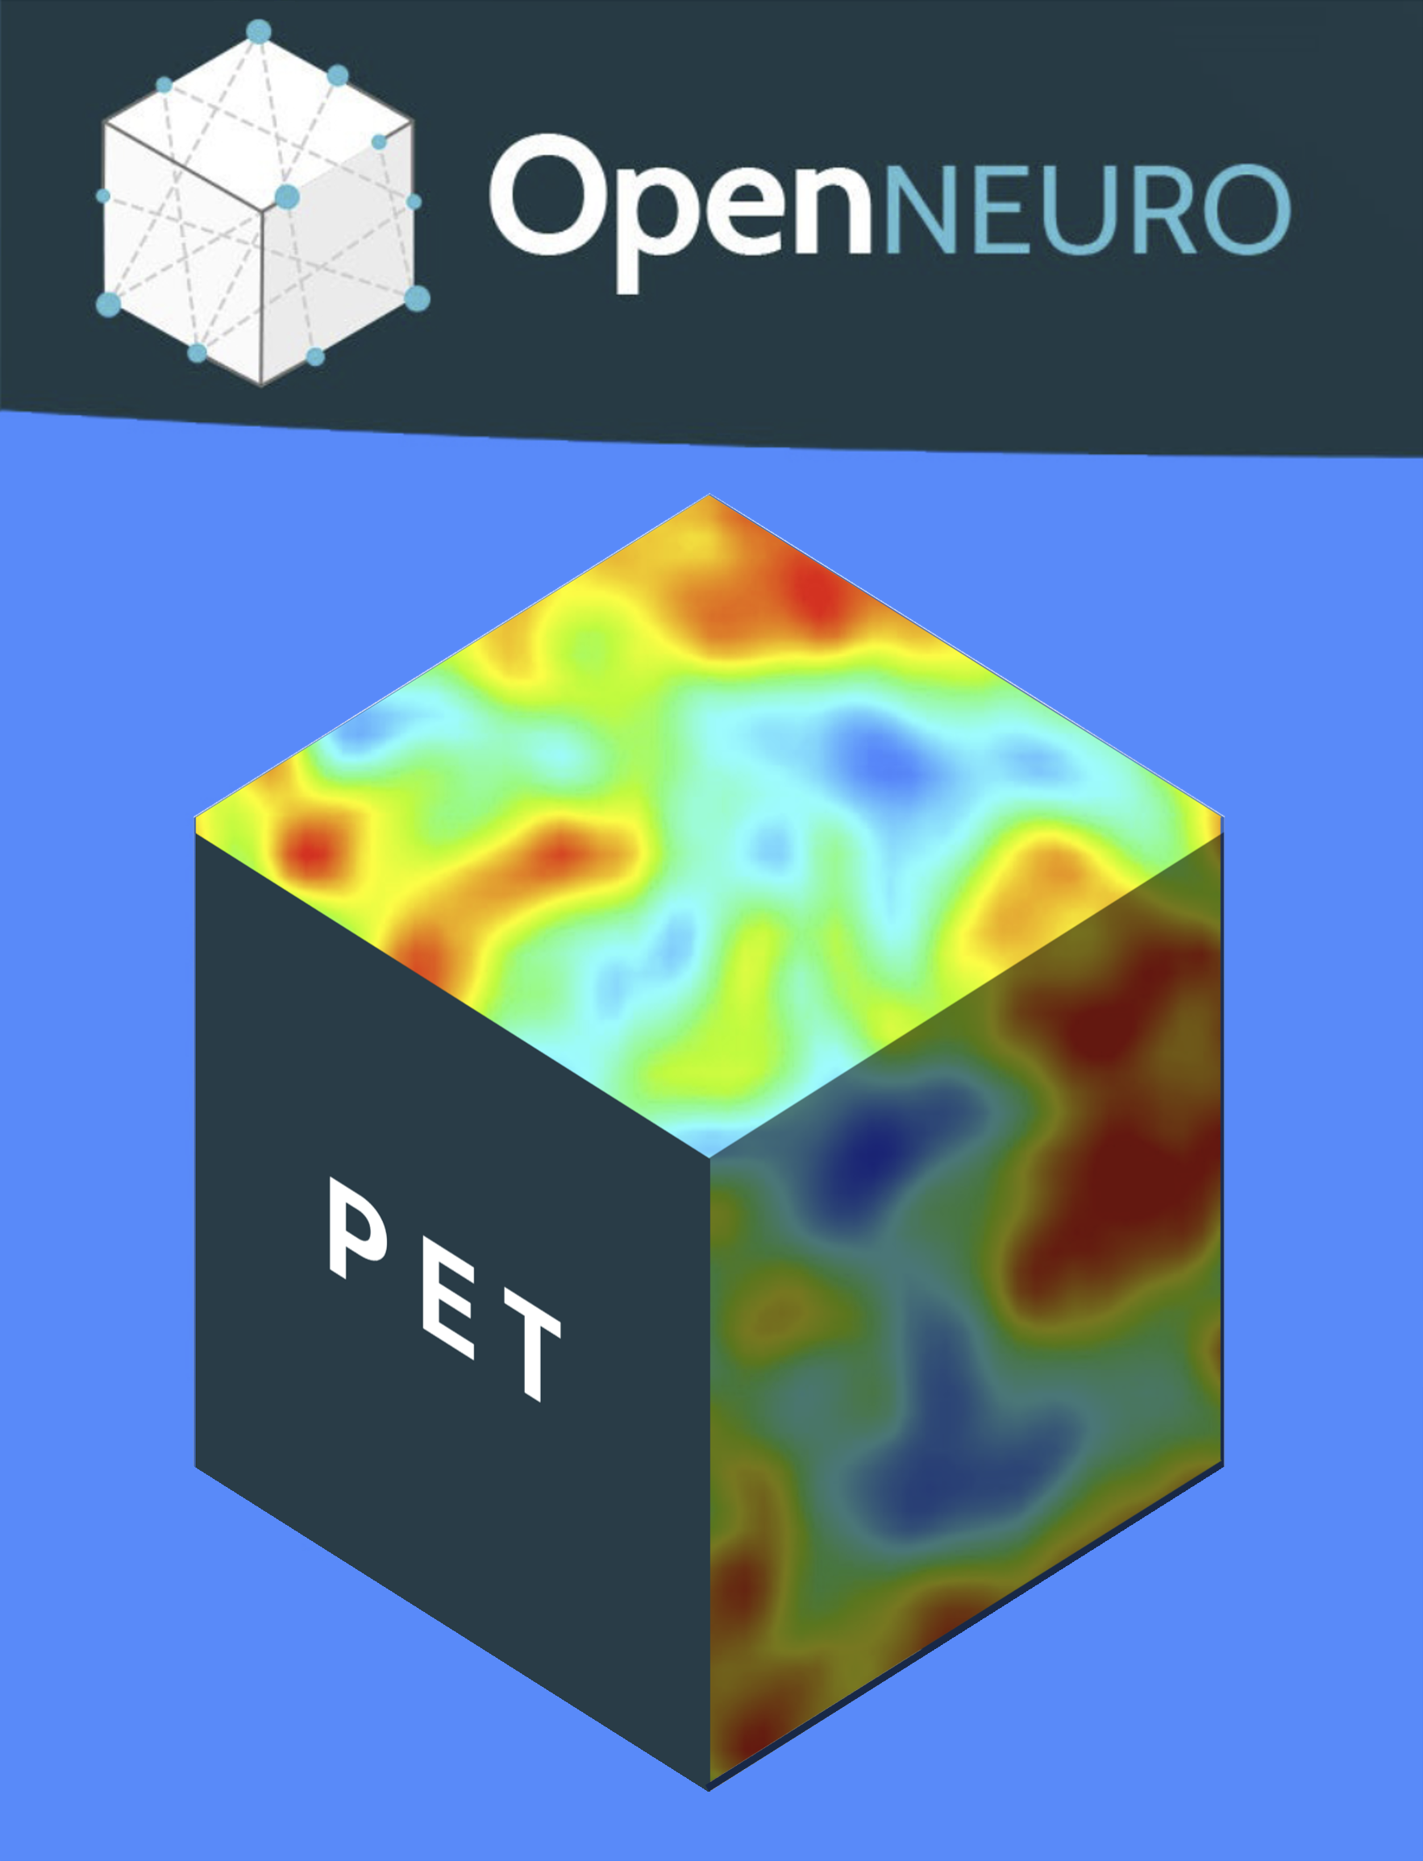



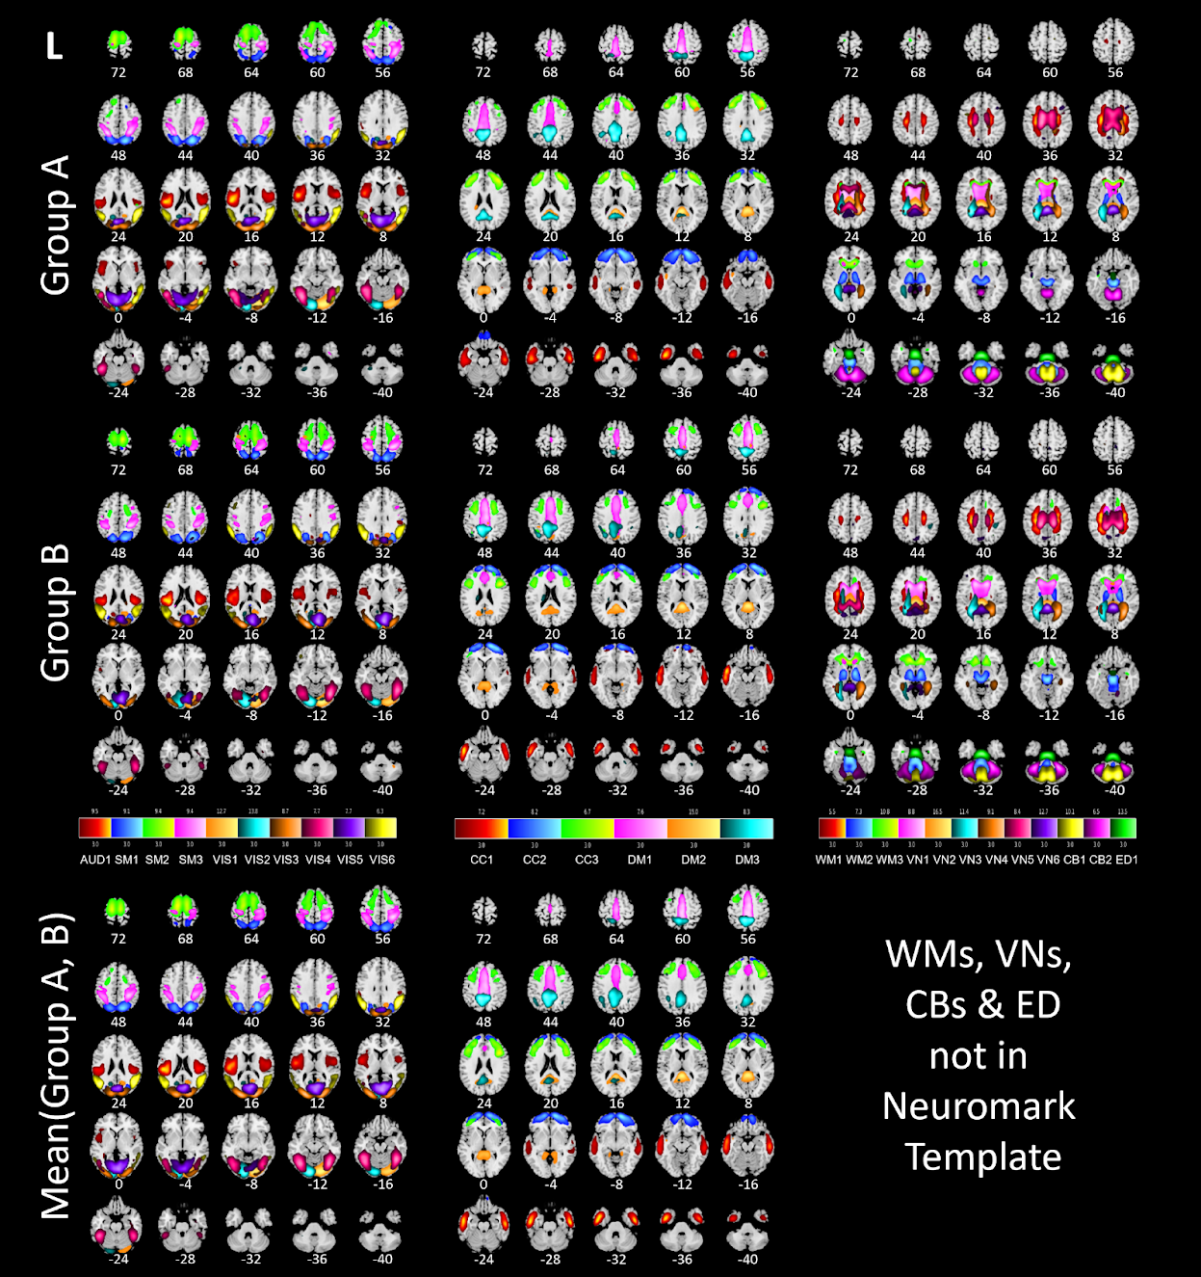
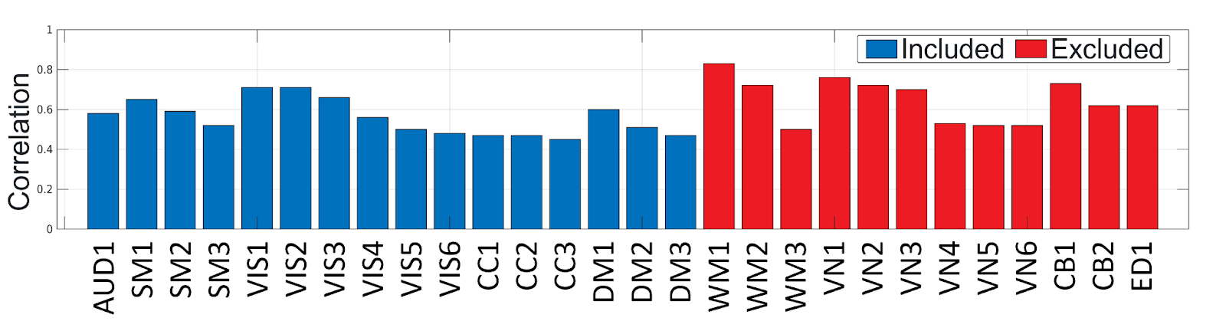
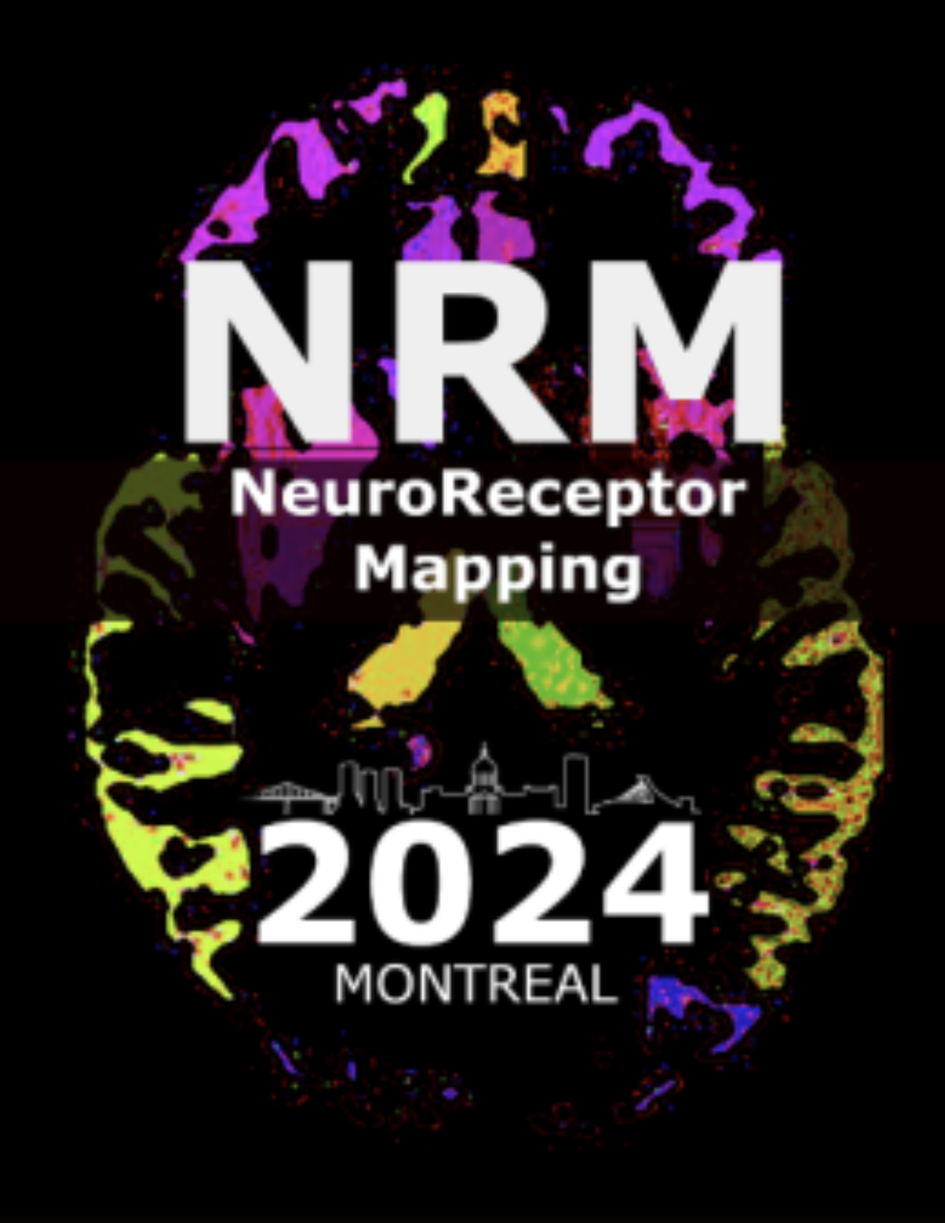
Neuromark PET: A fully automated ICA pipeline
for positron emission tomography images
Cyrus Eierudª, Martin Norgaard^{b,c}, Murat Bilgel^{d}, Granville Matheson^{e,f,g}, Anthony Galassi^{h}, Paul Wighton^{i}, Armin Irajiª, Zening Fuª, Helen Petropoulosª, Anastasia Bohsaliª, Jill Friesª, Gitte M. Knudsen^{j,k}, Melanie Ganz^{c,k}, Cyril Pernet^{k}, Vince Calhoun^{a,l,m}
Affiliations:
a) Tri-Institutional Center for Translational Research in Neuroimaging and Data Science (TReNDS), Georgia State University, Georgia Institute of Technology, Emory University, Atlanta, GA, United States. b) Molecular Imaging Branch, National Institute of Mental Health, National Institutes of Health, Bethesda, MD, USA. c) Department of Computer Science, University of Copenhagen, Copenhagen, Denmark. d) Laboratory of Behavioral Neuroscience, National Institute on Aging, Baltimore, USA, Baltimore, MD, USA. e) Department of Clinical Neuroscience, Center for Psychiatry Research, Karolinska Institutet, Stockholm, Sweden. f) Department of Psychiatry, Columbia University, New York, NY, USA. g) Department of Biostatistics, Columbia University, New York, NY, USA. h) Center for Multimodal Neuroimaging, National Institute of Mental Health, Bethesda, MD, USA. i) Athinoula A. Martinos Center for Biomedical Imaging, Massachusetts General Hospital, Charlestown, MA, USA. j) Department of Clinical Medicine at University of Copenhagen, Denmark. k) Neurobiology Research Unit, Rigshospitalet, Copenhagen, Denmark. l) Department of Psychology and Computer Science, Neuroscience Institute and Physics, Georgia State University, Atlanta, GA, USA. m) Department of Electrical and Computer Engineering, Georgia Institute of Technology, Atlanta, GA, USA
Background
Results
Positron emission tomography (PET) radioligand binding may not be aligned with commonly used parcellations of neocortex [1]
This work focuses on the beta-amyloid radioligand 18F-florbetapir (FBP)
Independent component analysis (ICA) provides a data-driven solution to estimate high-binding regions within the brain across participants
NeuroMark framework two steps for the GIFT software [2]:
GIFT developers create a template with manual interventions (this study)
GIFT users use a template on their subjects in a fully automated fashion
Templates may capture a wide range of reproducible brain markers across imaging modalities [3,4]
Spatial similarity (correlation in Fig. 1) was high between the two FBP groups (Fig. 2).
Methods
Subject data source: Alzheimer’s Disease Neuroimaging Initiative (ADNI) [5]
N=300 FBP PET and T1 MRI after excluding 22 misregistrations and artifacts
Cognitive normal participants
Divided by sorting subjects by age & sex: Group A (age=76.1 yrs, SD=8.1 yrs, n=150, f=54%) and group B (age=76.0 yrs, SD=7.9 yrs, n=150, f=53%)
Processed using PETprep_HMC [6], PetSurfer [7], PETPrepMATLAB [8,9] and FreeSurfer [10], into MNI152 space, averaging four 5-min frames
PET voxel intensities normalized to standardized uptake value ratios (SUVR) using the cerebellar cortex as the reference region [11,12]
GIFT ICA processing [2]:
Blind ICA, limited to 40 independent components (ICs), separately processed on groups A and B
Post processing by finding correlation between paired ICs across groups A & B:
Max paired correlation (group A of 40 ICs, group B of 40 ICs) > 0.4 [2]
Paired spatial ICs correlations < 0.4 between grps A & B may not be stable enough to reproduce for future ICAs and are therefore excluded [3]
Manual exclusion of ICs representing white matter, ventricles, cerebellar cortex, edge artifacts
Z-score Max:
9.5 9.1 9.4 9.4 12.7 13.8 8.7 7.7 7.7 6.3
7.2 8.2 6.7 7.6 15.0 8.3
5.5 7.3 10.8 8.8 16.5 11.4 9.1 8.4 12.7 10.1 6.5 13.5
Z-score Min:
3.0 3.0 3.0 3.0 3.0 3.0 3.0 3.0 3.0 3.0
3.0 3.0 3.0 3.0 3.0 3.0
3.0 3.0 3.0 3.0 3.0 3.0 3.0 3.0 3.0 3.0 3.0 3.0
Figure 2: Independent components (ICs) from group A at the top row, and group B in the middle row and the average between group A and B in the bottom row, which is the
Neuromark FBP template. Template ICs were separated in 5 domains, having auditory
(AUD), sensorimotor (SM) and visual (VIS) in the left column, cognitive-control (CC) and
default mode (DM) in the middle column, and the excluded ICs, white matter (WM),
ventricular (VN), cerebellar (CB) and an edge component (ED) that matched across
groups are in the right column.
Results
Out of the 40 ICs, 28 were replicable (ρ > 0.4, Fig. 1), including 16 meaningful components and 12 IC pairs deemed by evaluator unuseful or artifactual
Averaging the 16 meaningful IC pairs, between groups A & B, generating our NeuroMark PET FBP template, labeled according with domains shown in Fig. 1
Conclusion
The florbetapir PET NeuroMark template was created
The template can be used for a fully automated ICA pipeline implemented in the GIFT software [2]
Using Neuromark FBP, the uptake in the white matter and other regions are separated from the gray matter
Since florbetapir targets beta-amyloid plaques, the ICs of this NeuroMark template may indicate where beta-amyloid varies most across a cognitive normal population
The NeuroMark template may easily compare PET images from different populations (e.g., control vs disorder), similar with previous fMRI studies [13,14,15]
Figure 1: Each correlation shows similarity between the paired component in group A and the component in group B, having the components' NeuroMark FBP template labels on the x-axis. The components included in the NeuroMark FBP template have blue bars and are in the following domains: auditory (AUD), sensorimotor (SM), visual (VIS), cognitive-control (CC), or default mode (DM). The red bars show 12 excluded components, because they represent white matter (WM), ventricular regions (VN), cerebellar (CB) or is an edge artifact (ED).
Presenter: Martin Norgaard Corresponding author (Cyrus Eierud) : ceierud@gsu.edu
References:
Beliveau V. Neuroimage. 2020
Correa N. IEEE. 2005
Du Y. Neuroimage Clin. 2020
NeuroMark info., https://trendscenter.org/data/
ADNI, https://adni.loni.usc.edu/
Petprep_hmc source code, https://github.com/mnoergaard/petprep_hmc
PetSurfer wiki, https://surfer.nmr.mgh.harvard.edu/fswiki/PetSurfer
Norgaard M. Biorxiv. 2021
PetprepMATLAB source code, https://github.com/mnoergaard/petprepMATLAB
Dale, A.M. NeuroImage 1999
TReNDs Pet processing info., https://github.com/trendscenter/gift-bids/tree/main/misc/pet/pipe/onp
TReNDs Pet processing scripts, https://github.com/trendscenter/gift-bids/tree/main/misc/pet/pipe/onp/example_fbb
Levey A.I. Brain. 2022
Fu Z. Frontiers in Neuroscience. 2021
Fu Z. Neurobiology of stress. 2021

